Slide 1



SIGNALS & MOMENTS
Feature Summary

Slide 2

Marigold
Signals & Moments
Engage consumers in-the-moment by listening to consumer signals and detecting valuable moments in the customer lifecycle

Slide 3



Product Value
Proposition

Slide 4



RELEVANCE
Realtime hyper-personalization you can trust
ENGAGE THE RIGHT AUDIENCE
Create precise audience segmentation based on the real interests of your consumers
WITH THE RIGHT CONTENT
Build rich messages filled with static and dynamic engagement content personalized to each recipient
AT THE RIGHT MOMENT
Capture the attention of your audience with messages triggered at precisely the right moment in time
+ SIGNALS & MOMENTS

Slide 5


Example Use Cases

Slide 6



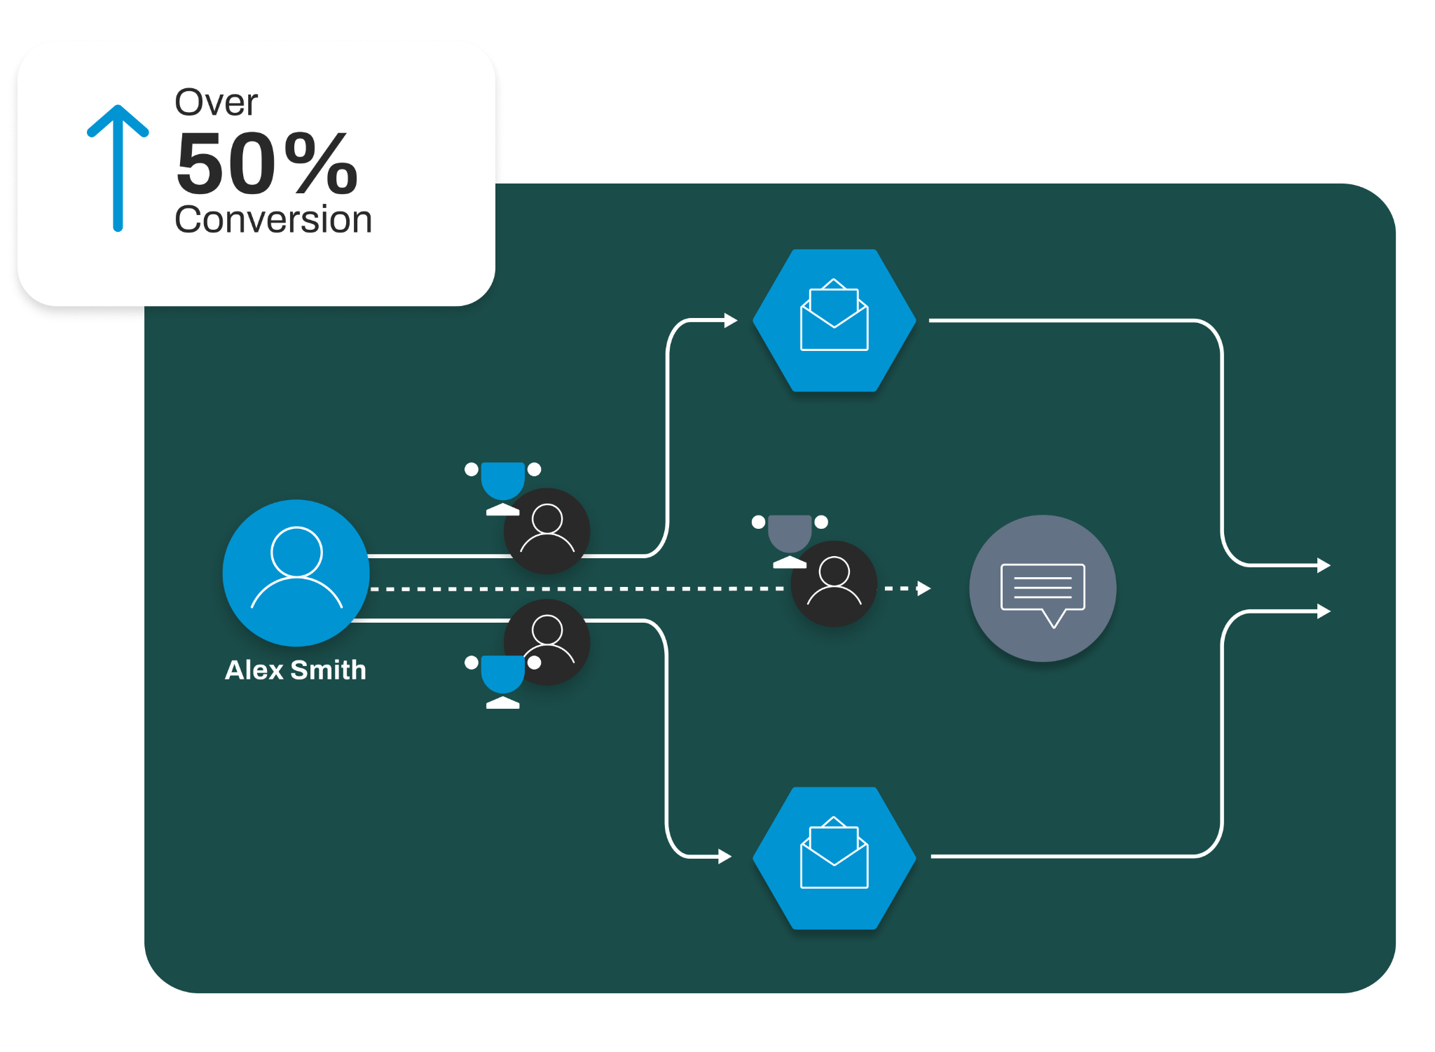

RETAIL
Increase conversions for abandoned carts
1
2
3
Trend is a retail website selling shoes and accessories. They’re looking to reduce the number of abandoned baskets they have
The team would like to send email notifications to customers with abandoned baskets
By using Moments, Trend is able to identify those customers with open baskets and send them a targeted offer, with a call to action to return and complete the purchase
By using Moments, with the Marigold platform, Trend is able to send specific abandoned cart notifications
This increases the conversion rate of abandoned baskets, boosting website revenue for Trend
👔We’ve saved your basket, don’t miss out on these great items!🛍️

Slide 7

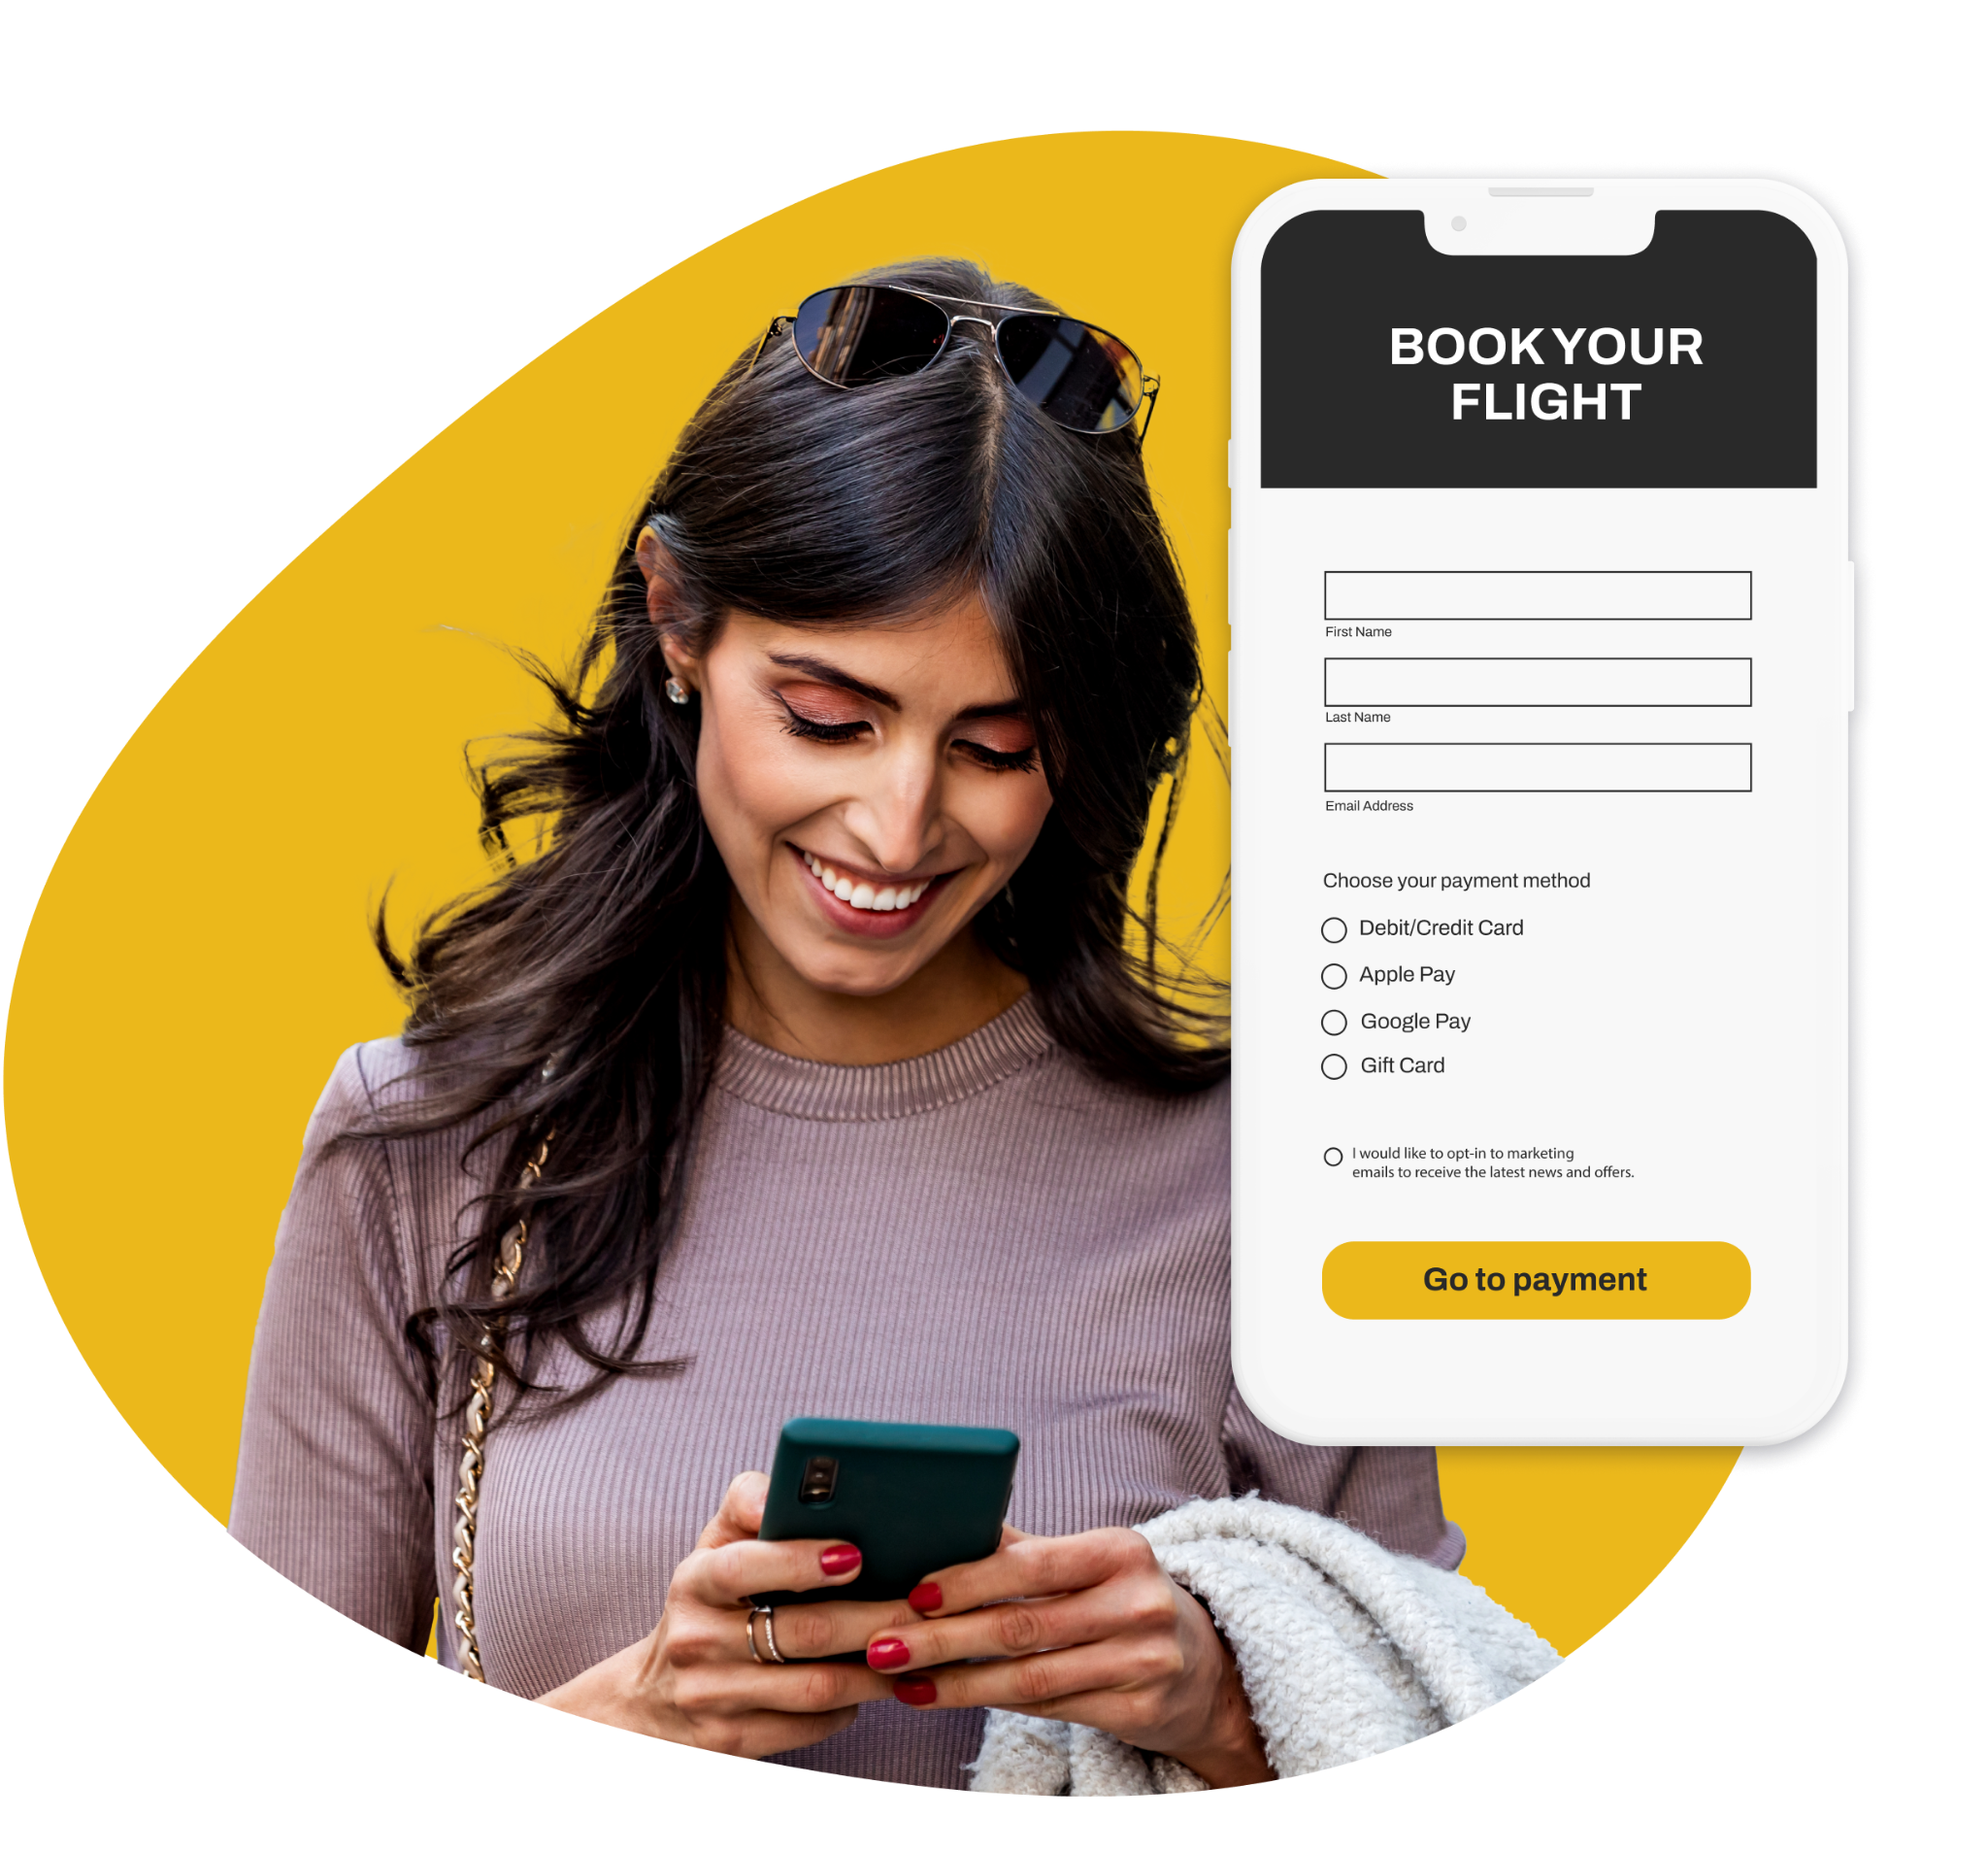
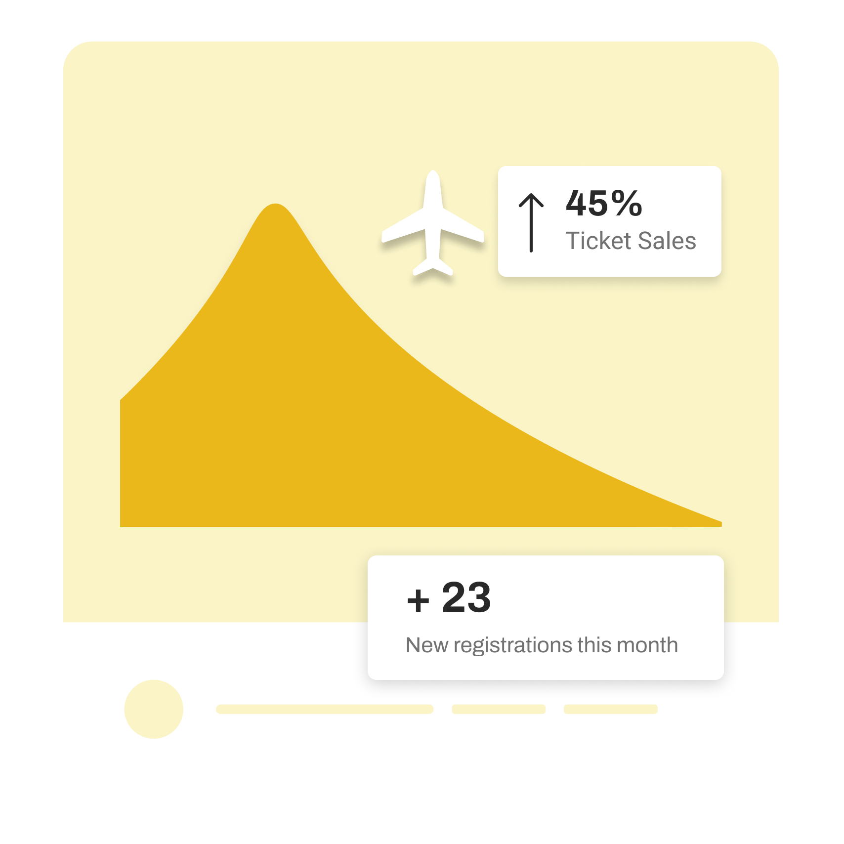
TRAVEL & HOSPITALITY
Improve completion for incomplete bookings
1
2
3
TravelThere is a travel booking website where users can rapidly find available flights for a destination on a given date
Many of the users who browse the website every day start a booking but do not complete
By using Moments, TravelThere is able to identify those customers with incomplete bookings and send them a reminder with a call to action to return and complete the purchase
By using Moments, with the Marigold platform, TravelThere is able to send specific incomplete booking notifications
This increases the conversion rate of online bookings, boosting website revenue for TravelThere

Slide 8



Thank
you!

